Slide 1


May 21, 2024
CIS
Lab
Evaluating Streamflow Forecasts in Hydro-Dominated Power Systems:
When and Why They Matter
Rachel Koh^{1,2}
Stefano Galelli^{2,3}
¹Centre for Climate Research Singapore
²Singapore University of Technology and Design
³Cornell University

Slide 2




Value of streamflow forecasts
Common metrics
Flood control
Irrigation supply
Typically based on the output of a water system model
Spilled water
Hydropower ‘production’

Slide 3
Value of streamflow forecasts
Common metrics
Flood control
Irrigation supply
Spilled water
Hydropower ‘production’
Overlooks the role played by dams and forecasts in the power system
Notes:
In particular, it is important to understand which aspects of power system operations are improved by the use of streamflow forecasts, when forecasts are most useful, and how forecast predictive performance translates into different metrics of system performance. All these aspects would indeed be relevant to support the operationalization of streamflow forecasts.

Slide 4
Research questions
How does forecast value change as we consider different performance aspects of a power grid? When is the use of forecasts more beneficial?
How does forecast predictive performance affect power system operations?
Is forecast value affected by the interdependencies of the water-energy system?

Slide 5
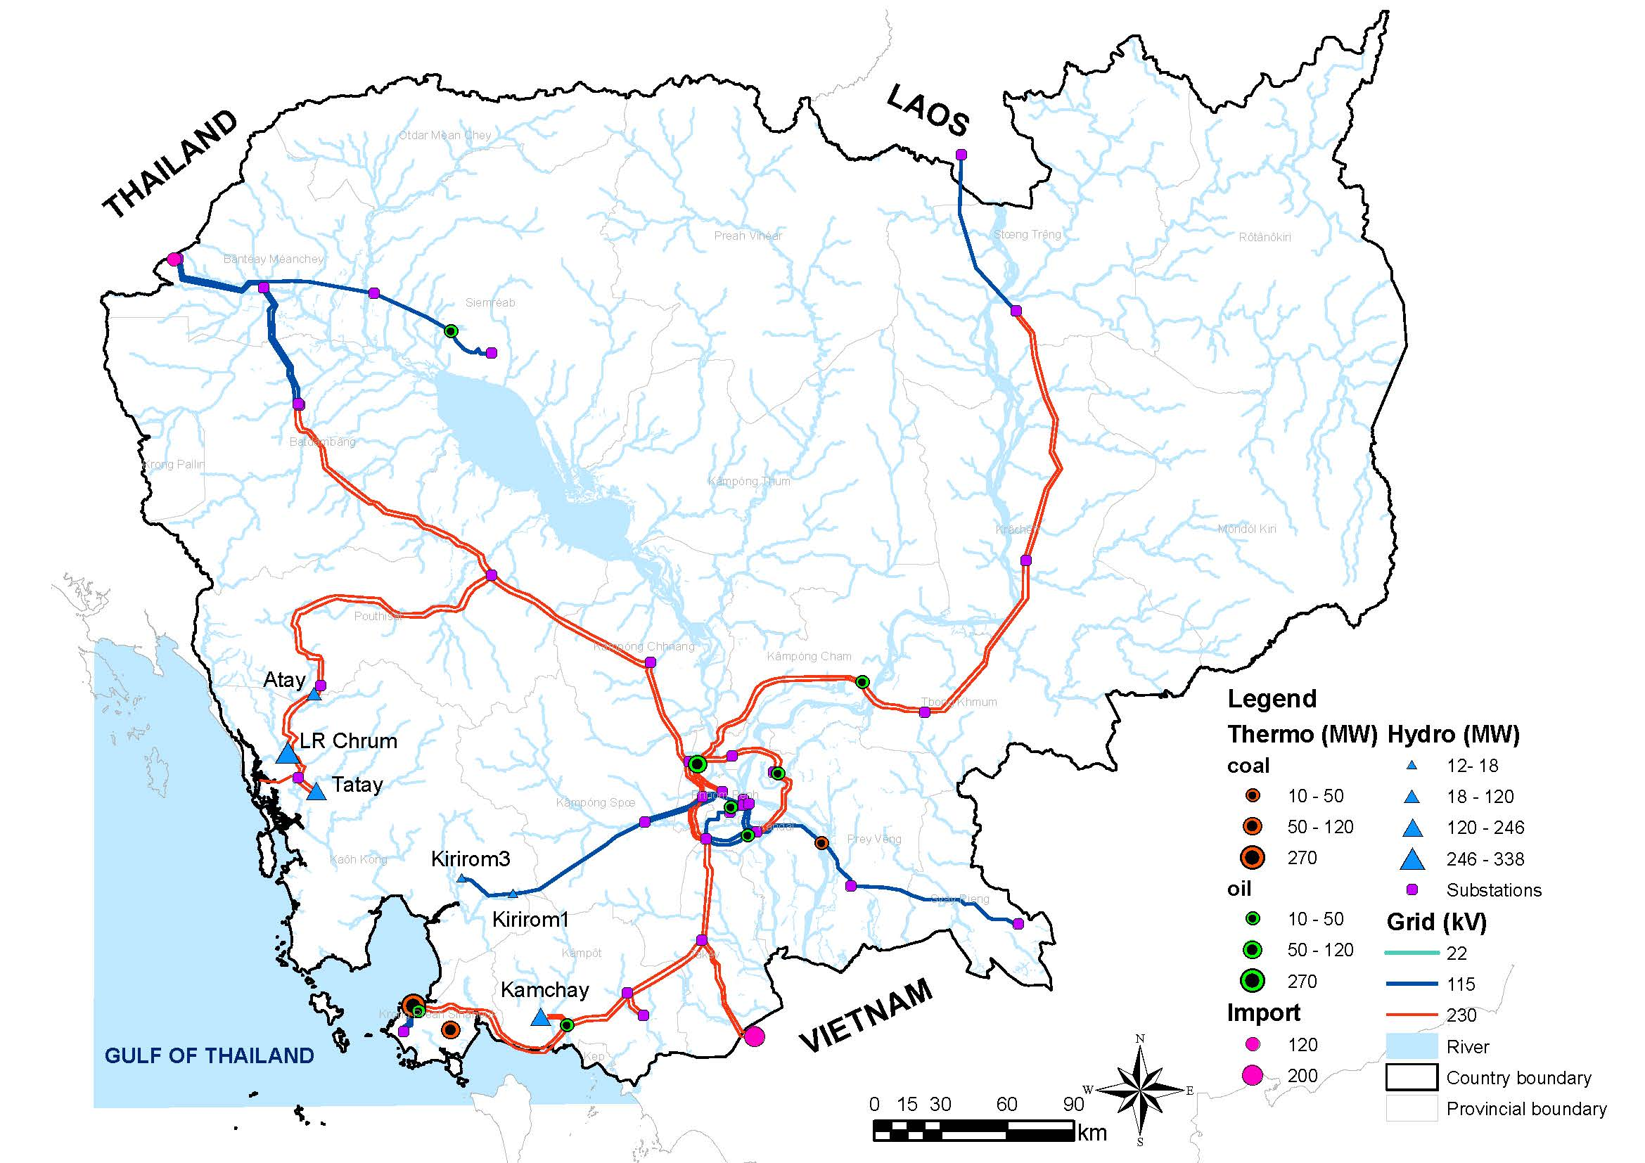
Case study
Cambodian power system
6 hydropower dams (1,048 MW)
18 thermoelectric units (682 MW)
Import from Thailand, Laos, and Vietnam
Peak demand of 1,068 MW

Slide 6
Data
Inflow to hydropower reservoirs
Retrieved from the Global Flood Awareness System (GloFAS) database
From 1979 to near real‐time with daily resolution
Inflow forecasts
Retrieved from GloFAS
Available for 2 days weekly (every Monday and Thursday)
24‐hr time step and up to 46‐day lead time
From January 1999 to December 2018
Common period 2000-2018
Notes:
Add a figure from a GloFAS paper / website

Slide 7
Models
Generation technology
Inflow /
Inflow forecasts
Target storage levels
Dispatchable hydropower
Water system model
Streamflow routing module (with dam operations)
Reservoir storage, release, dispatchable hydropower

Slide 8
Models
Generation technology
Dispatchable wind
and solar
Other parameters
Hourly electricity demand
Techno-economic parameters of thermoelectric units
Inflow /
Inflow forecasts
Target storage levels
Transmission capacity
Dispatchable hydropower
Water system model
Streamflow routing module (with dam operations)
PowNet
(MILP problem: minimize production cost, meet demand)
Generation mix
+
Costs, CO₂ emissions, N-1 violations
Reservoir storage, release, dispatchable hydropower
Chowdhury et al. (2020), Journal of Open Research Software, 8(1).

Slide 9
Models
Generation technology
Dispatchable wind
and solar
Other parameters
Hourly electricity demand
Techno-economic parameters of thermoelectric units
Inflow /
Inflow forecasts
Target storage levels
Transmission capacity
Dispatchable hydropower
Water system model
Streamflow routing module (with dam operations)
PowNet
(MILP problem: minimize production cost, meet demand)
Dispatched hydropower
Generation mix
+
Costs, CO₂ emissions, N-1 violations
Reservoir storage, release, dispatchable hydropower
Chowdhury et al. (2020), Journal of Open Research Software, 8(1).

Slide 10
Experimental setup
Reservoir operating schemes
Static rule curves (no forecasts)
Model Predictive Control (forecast-informed)
Perfect forecasts
Climatology
Ensemble mean

Slide 11
Experimental setup
Forecast predictive performance
Symmetric Mean Absolute Percentage Error (SMAPE)
Forecast value
Dispatchable hydropower
Dispatched and unused hydropower
System operating costs
CO₂ emissions
Number of N‐1 violations
Water system model
PowNet

Slide 12
Results
Value of streamflow forecasts
Not all available hydropower is dispatched by the grid
Defining value in terms of different metrics leads to different conclusions
The benefits of operating with forecasts are accentuated during the post-monsoon season

Slide 13
Results
Value of streamflow forecasts

Slide 14
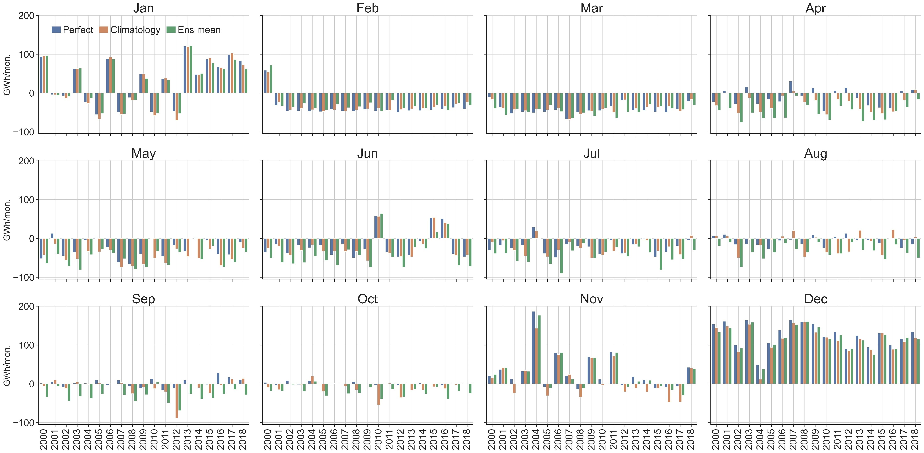
Results
Intra‐ and Inter‐Annual Variability of Forecast Value
Difference between hydropower dispatched by forecast-informed schemes and rule curves

Slide 15
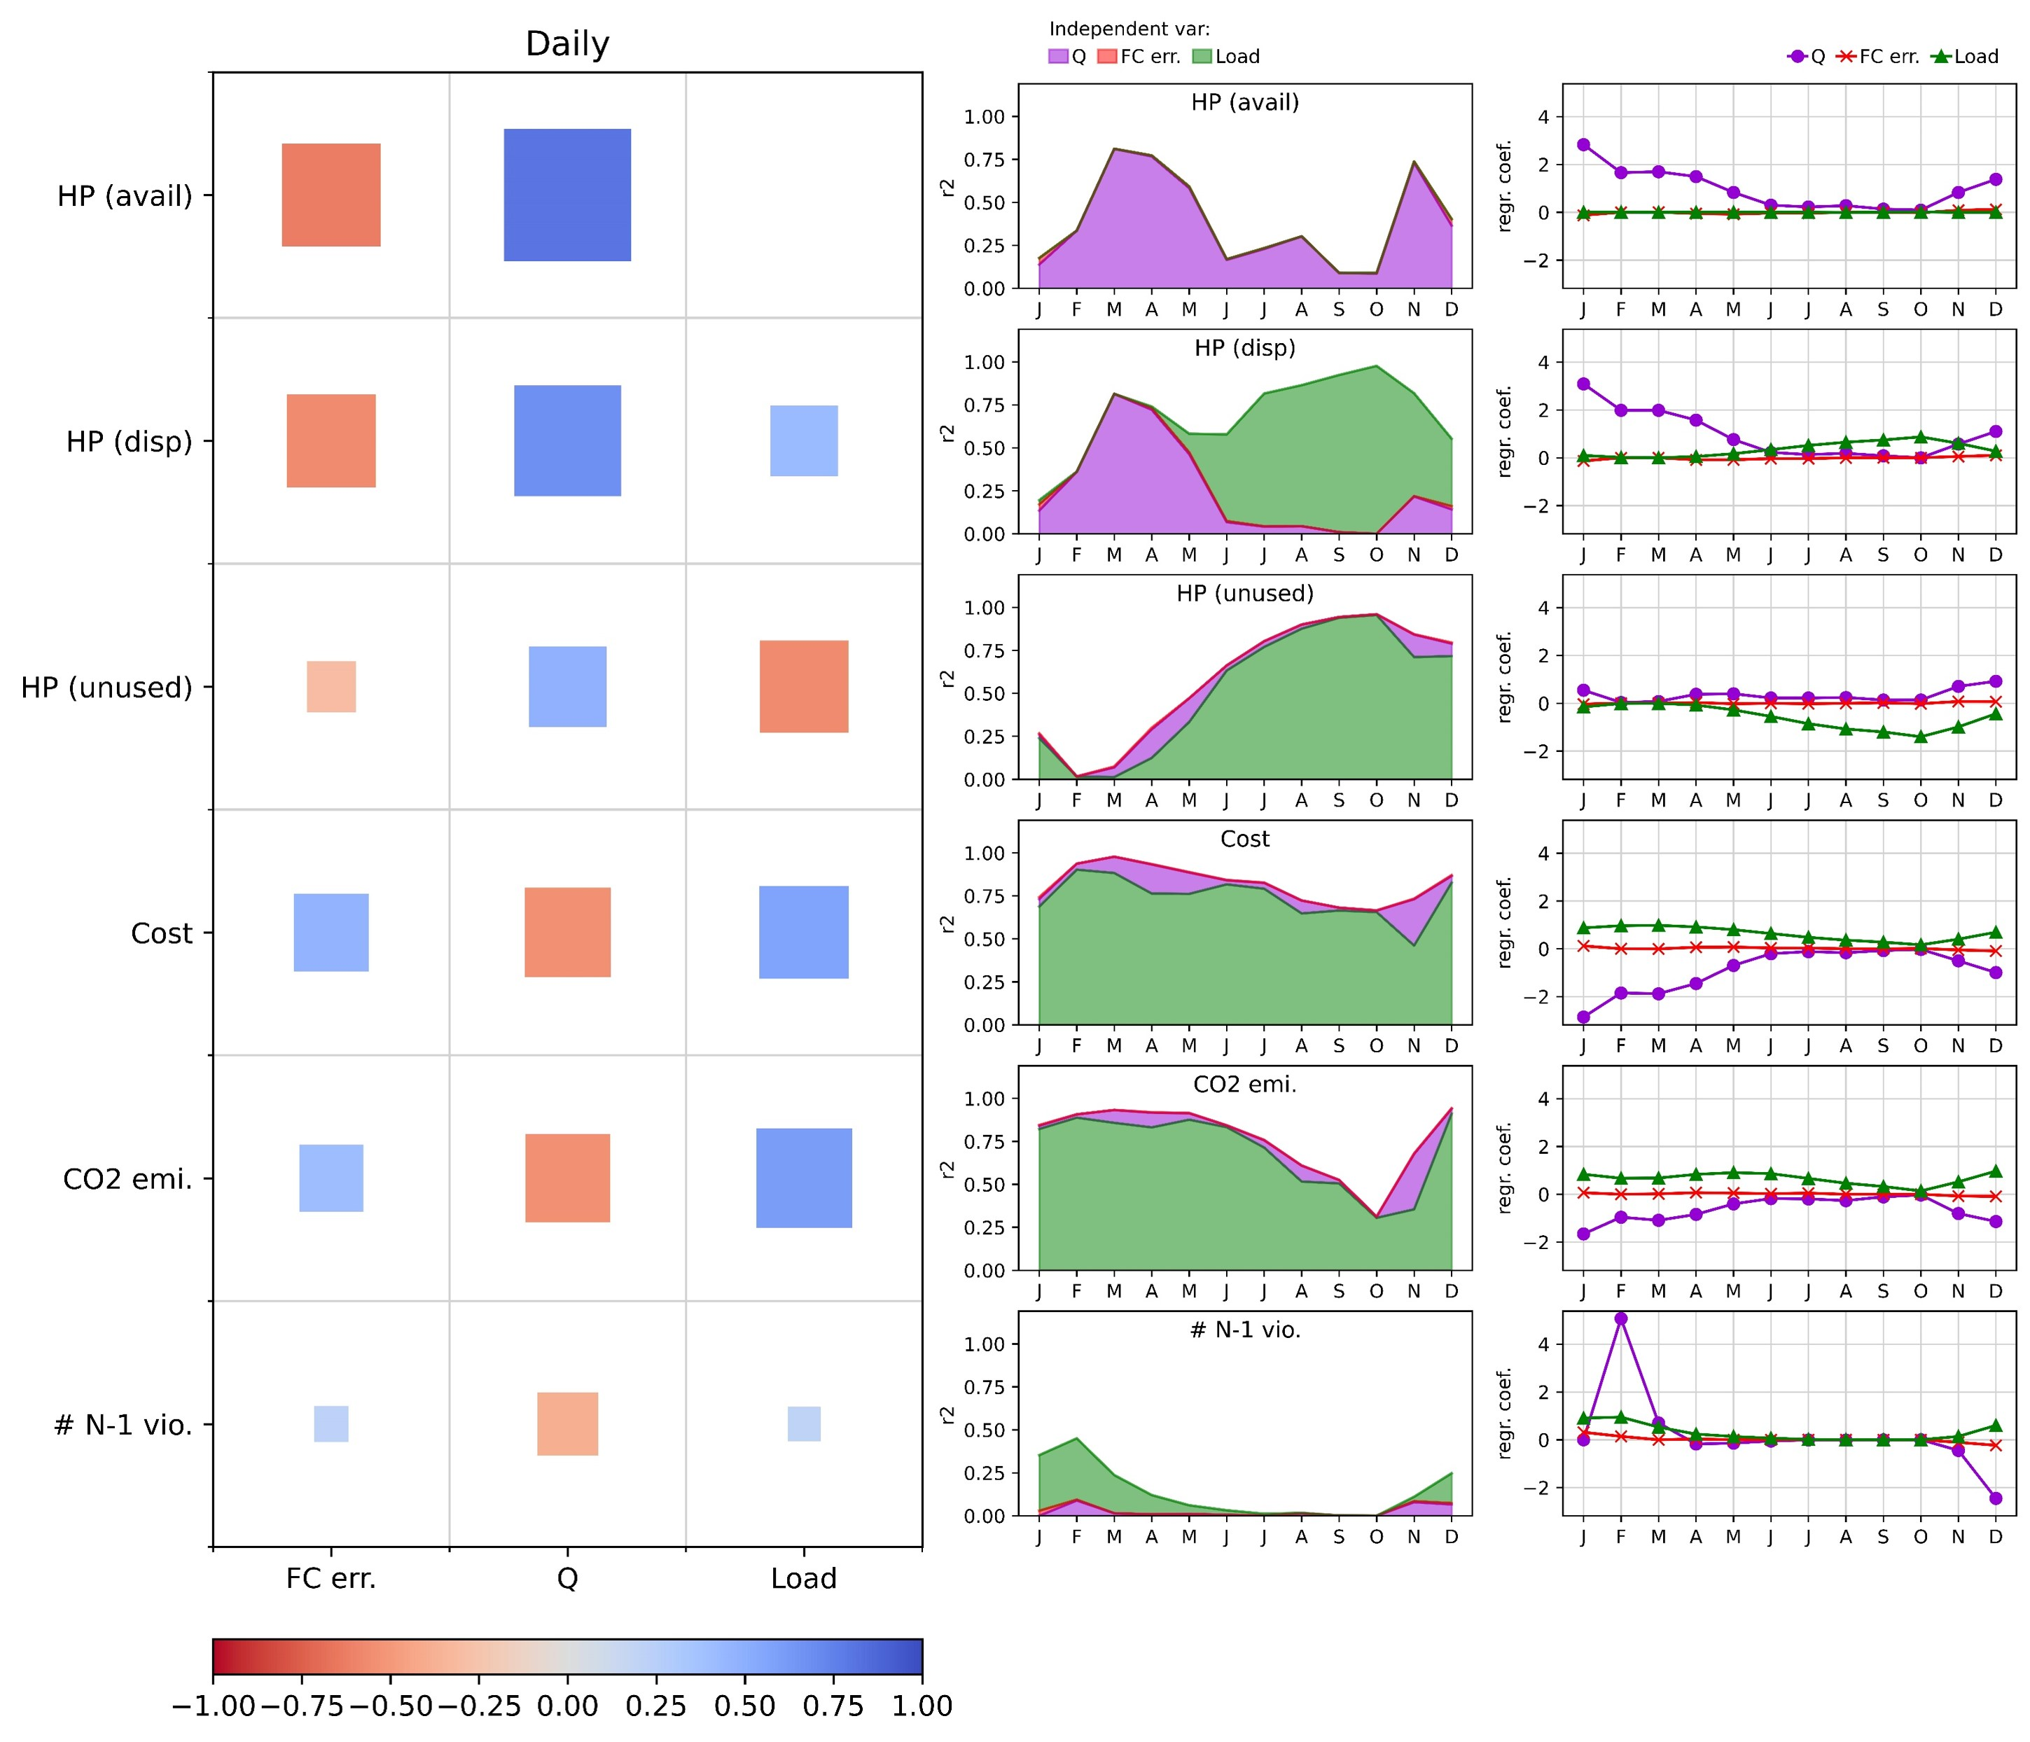
Results
Relationship Between Forecast Predictive Performance and Value
The correlation between forecast error and performance metrics decreases as we ‘move’ from the water to the power system.

Slide 16
Results
Relationship Between Forecast Predictive Performance and Value

Slide 17
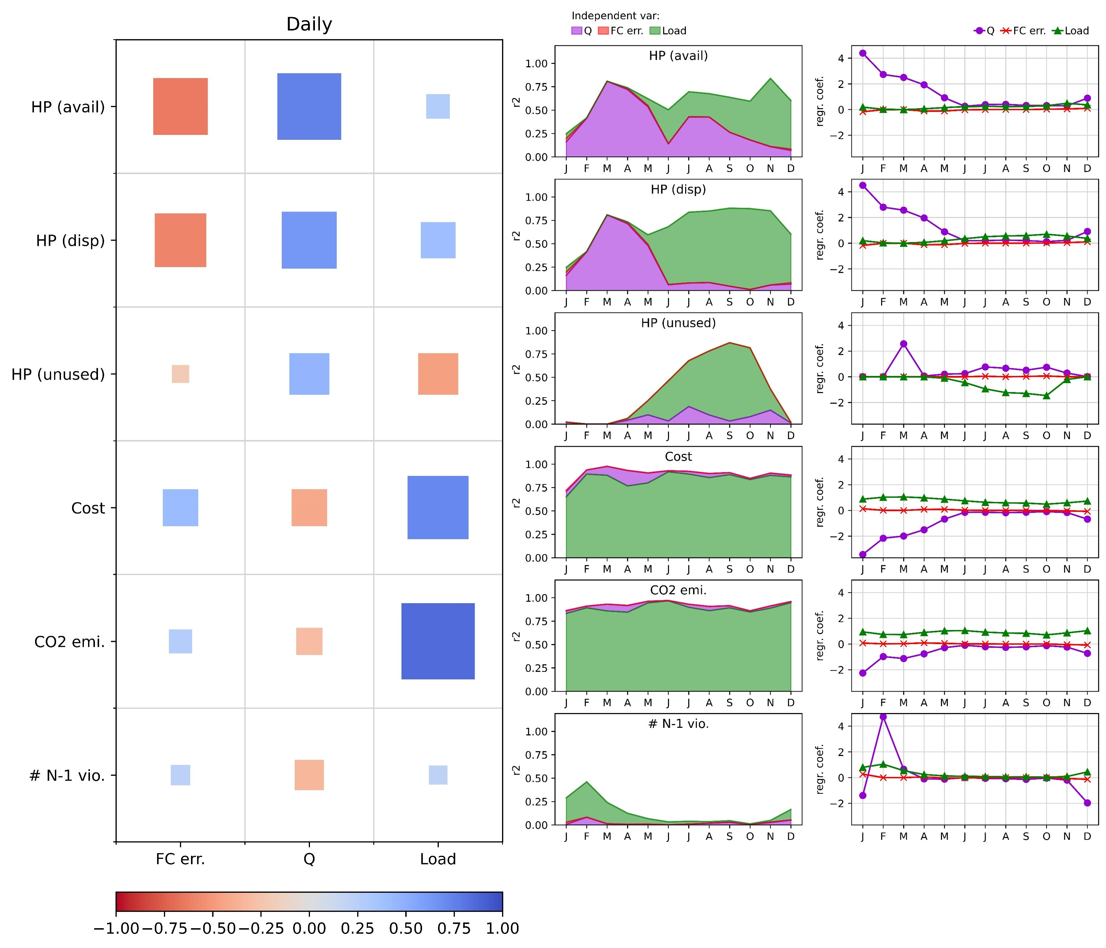
Results
Effect of re-operation

Slide 18
Conclusions
Defining forecast value in terms of different performance metrics produces different outcomes
Measuring value in terms of available hydropower gives us a narrow view of forecast value
Streamflow forecasts are useful (in terms of costs, CO₂ emissions etc.) but such value changes throughout the year
A tighter integration of water and power system operations enhances the role of electricity demand and dwarfs the role forecasts

Slide 19
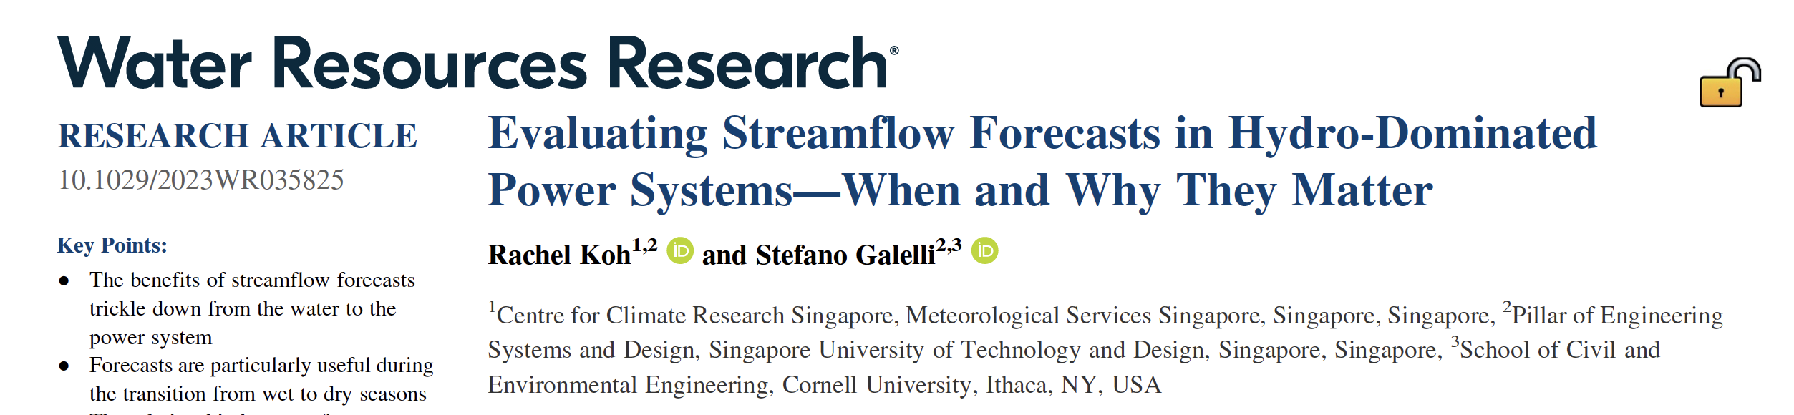





Thank you!
galelli@cornell.edu
https://galelli.cee.cornell.edu
@GalelliStefano

Slide 20
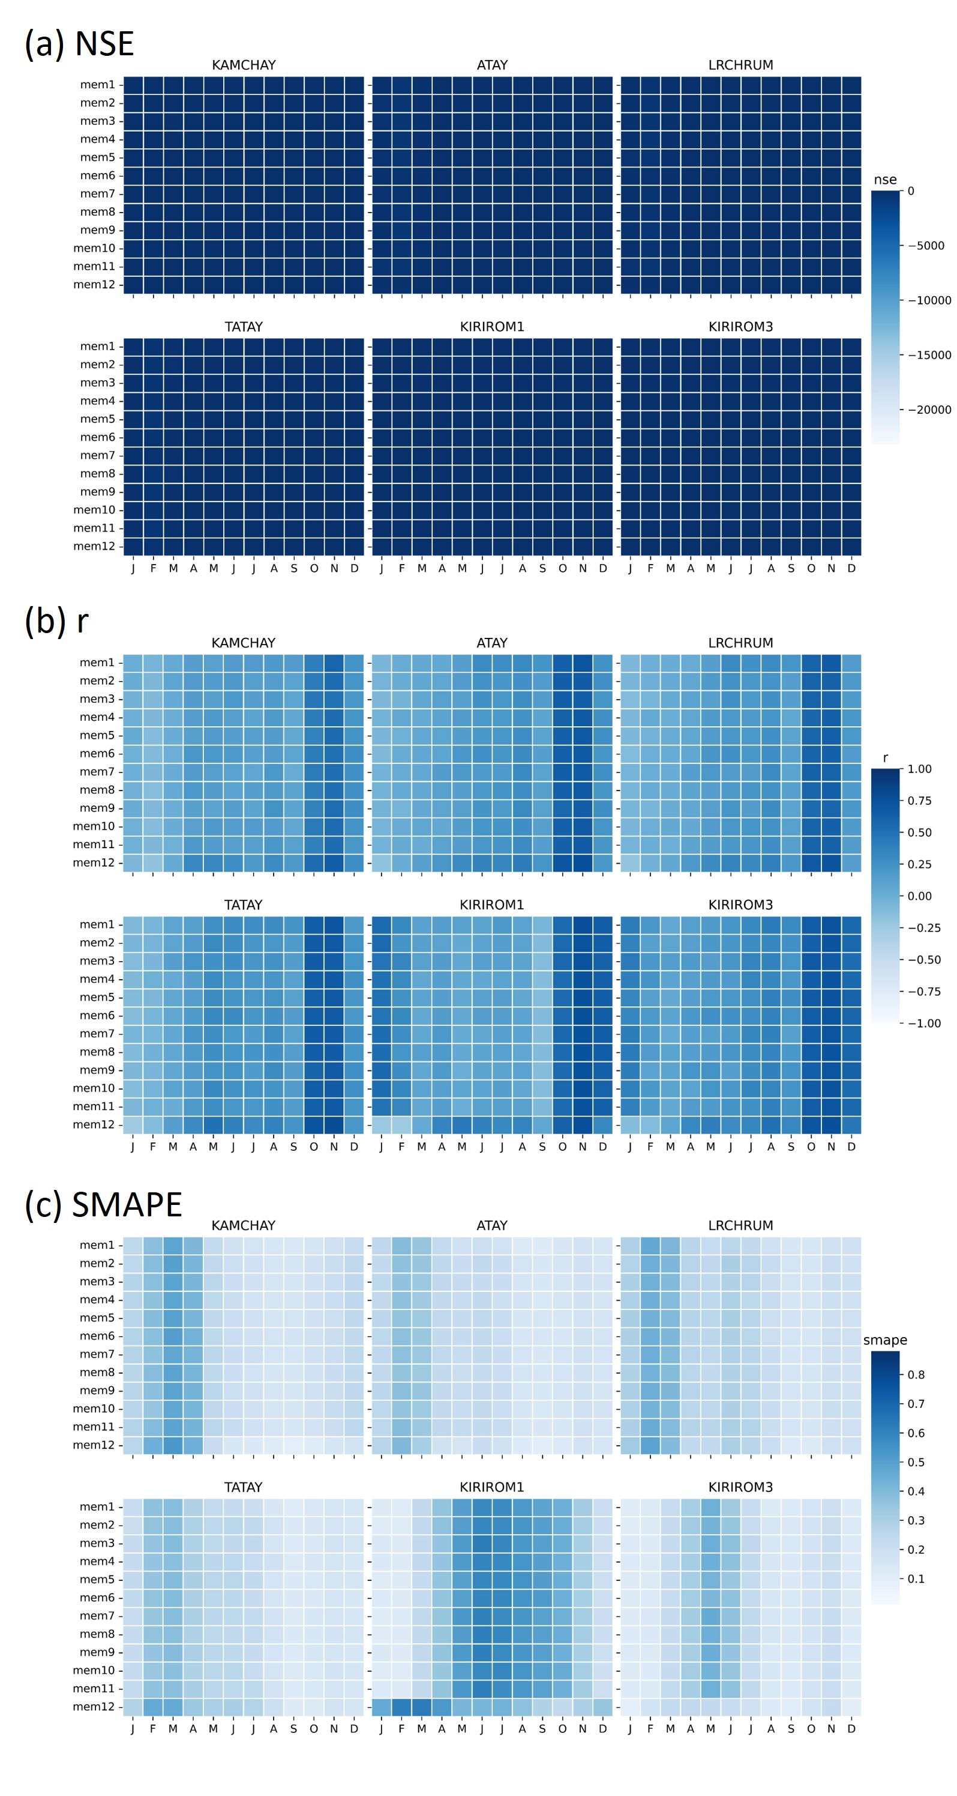
Forecast predictive performance

Slide 21
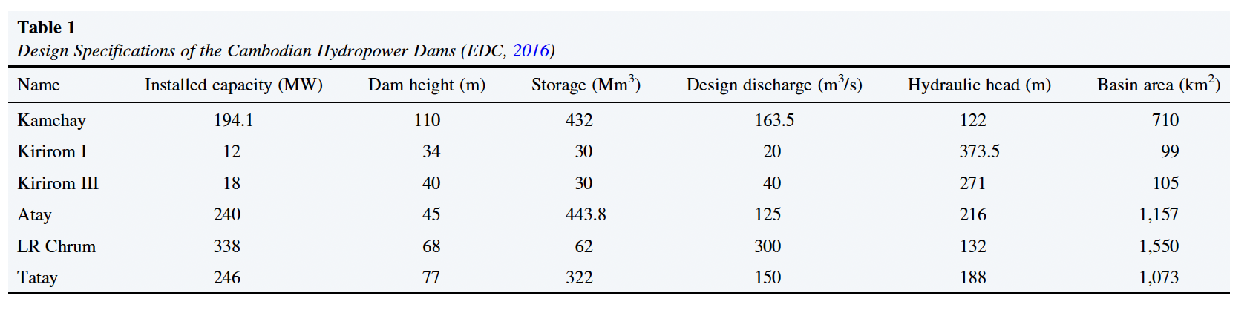
Design specifications of dams

Slide 22
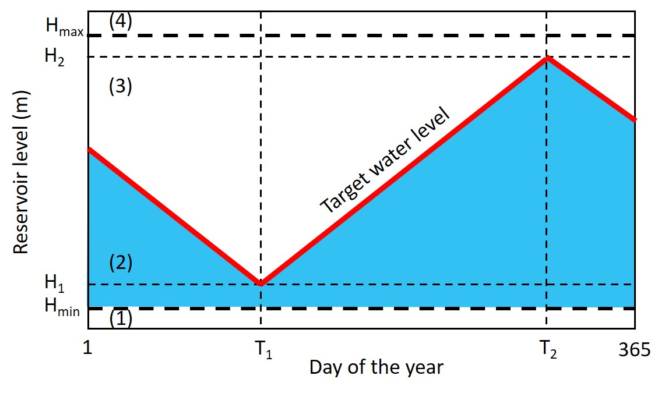
Rule curves
Example

Slide 23
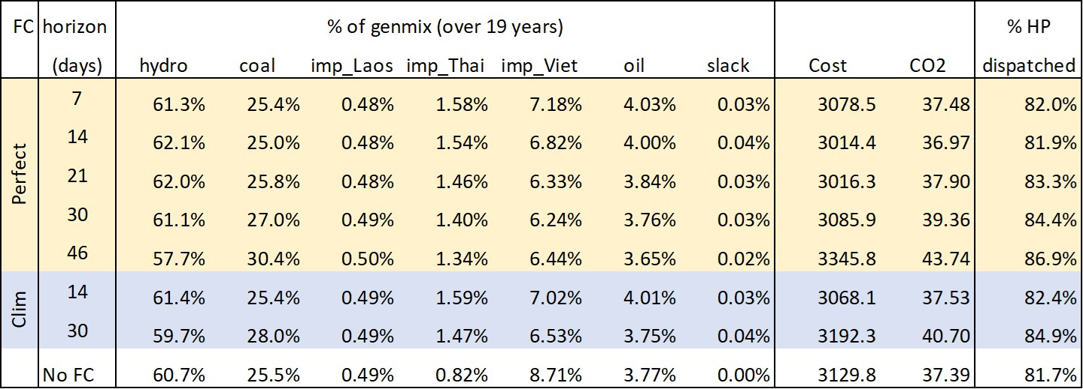
Choice of the MPC horizon

Slide 24
Generation mix

Slide 25
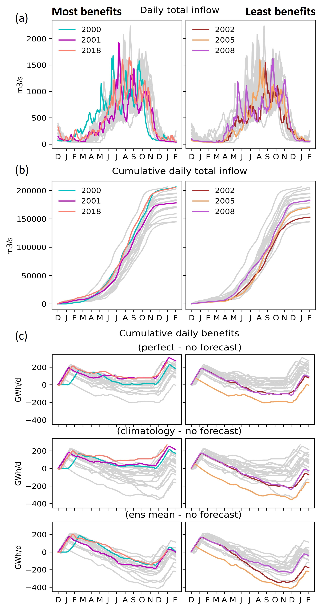
Results
Intra‐ and Inter‐Annual Variability of Forecast Value
Hydrological conditions that are favorable to forecast-informed schemes

Slide 26
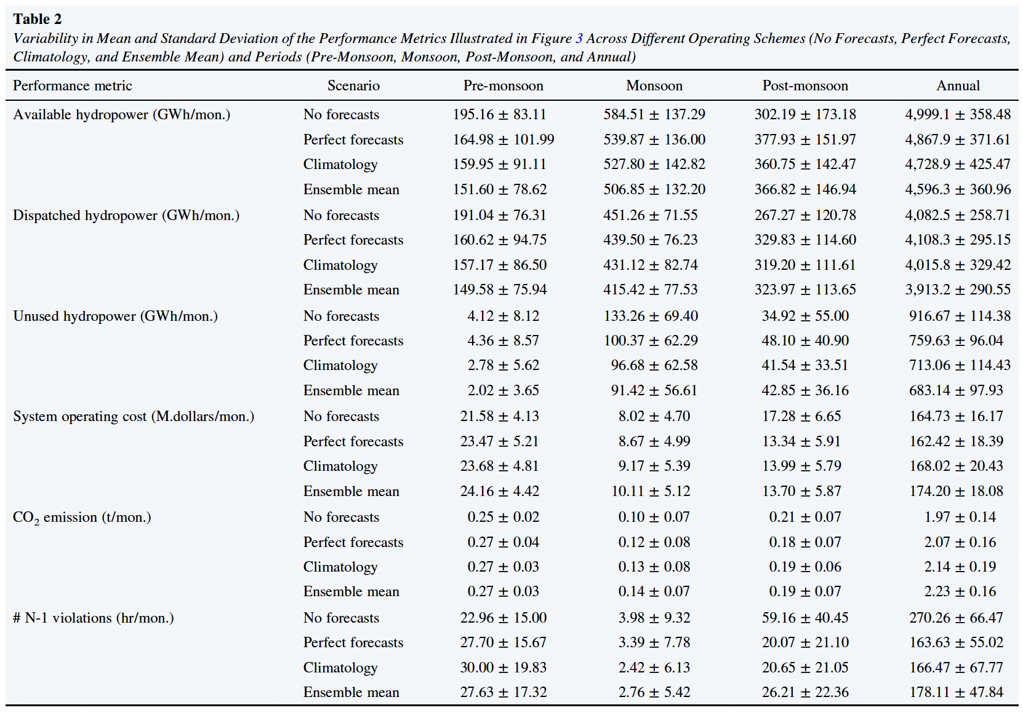
Value of streamflow forecasts

